Slide 1



Sales-Revenues Dashboard
View in Power BI
Last data refresh:
6/6/2026 7:07:10 PM UTC
Downloaded at:
6/13/2026 12:24:33 PM UTC

Slide 2
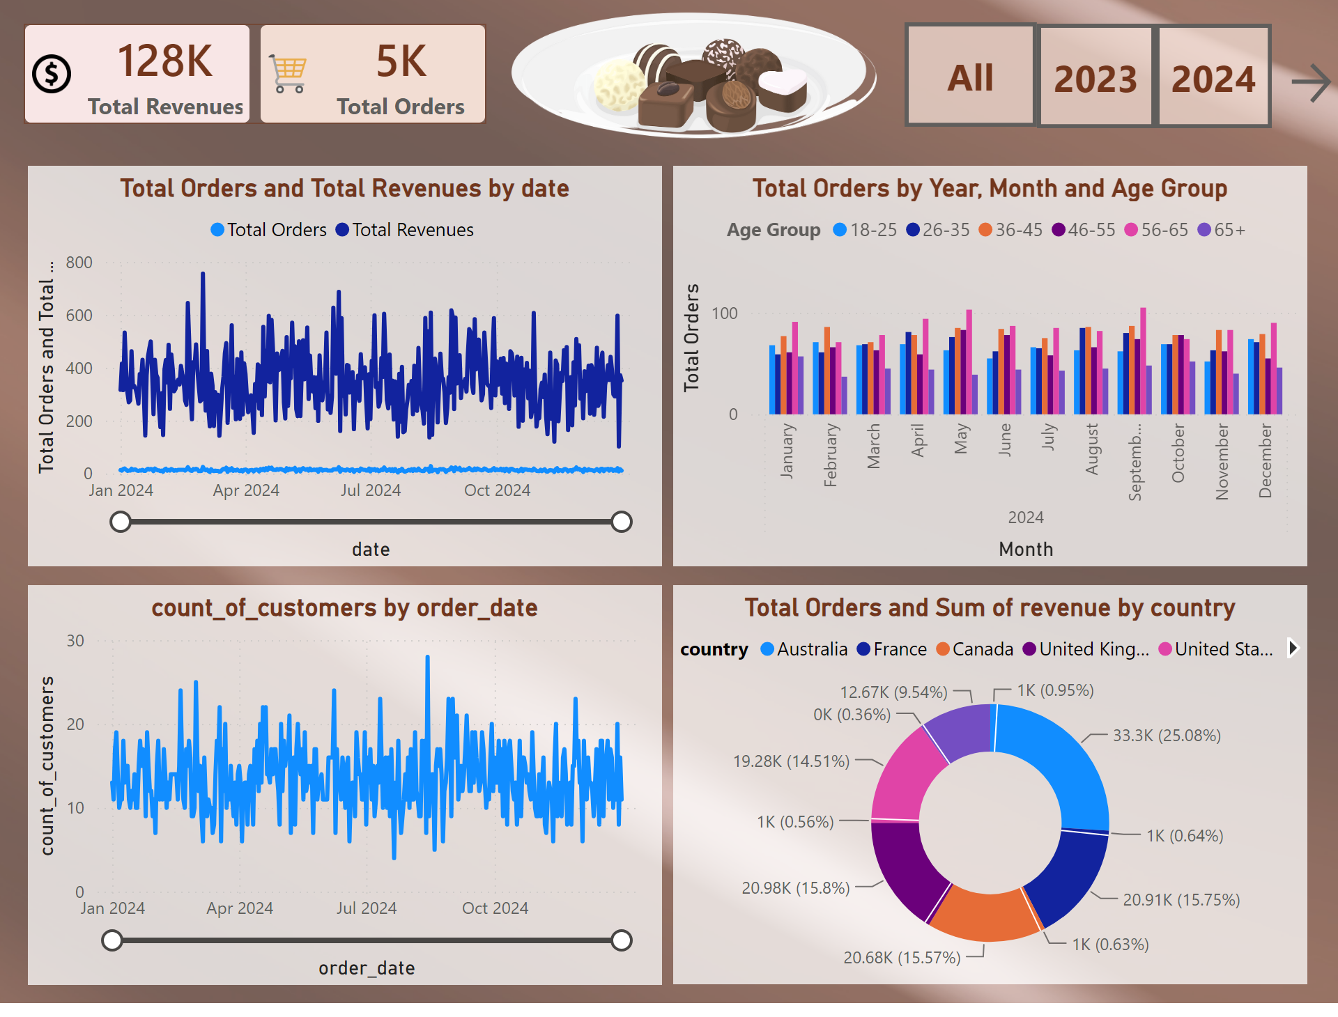
Notes:
donutChart
No alt text provided
lineChart
No alt text provided
lineChart
No alt text provided
clusteredColumnChart
No alt text provided
cardVisual
No alt text provided
actionButton
No alt text provided
actionButton
No alt text provided
actionButton
No alt text provided
image
No alt text provided
actionButton
No alt text provided

Slide 3
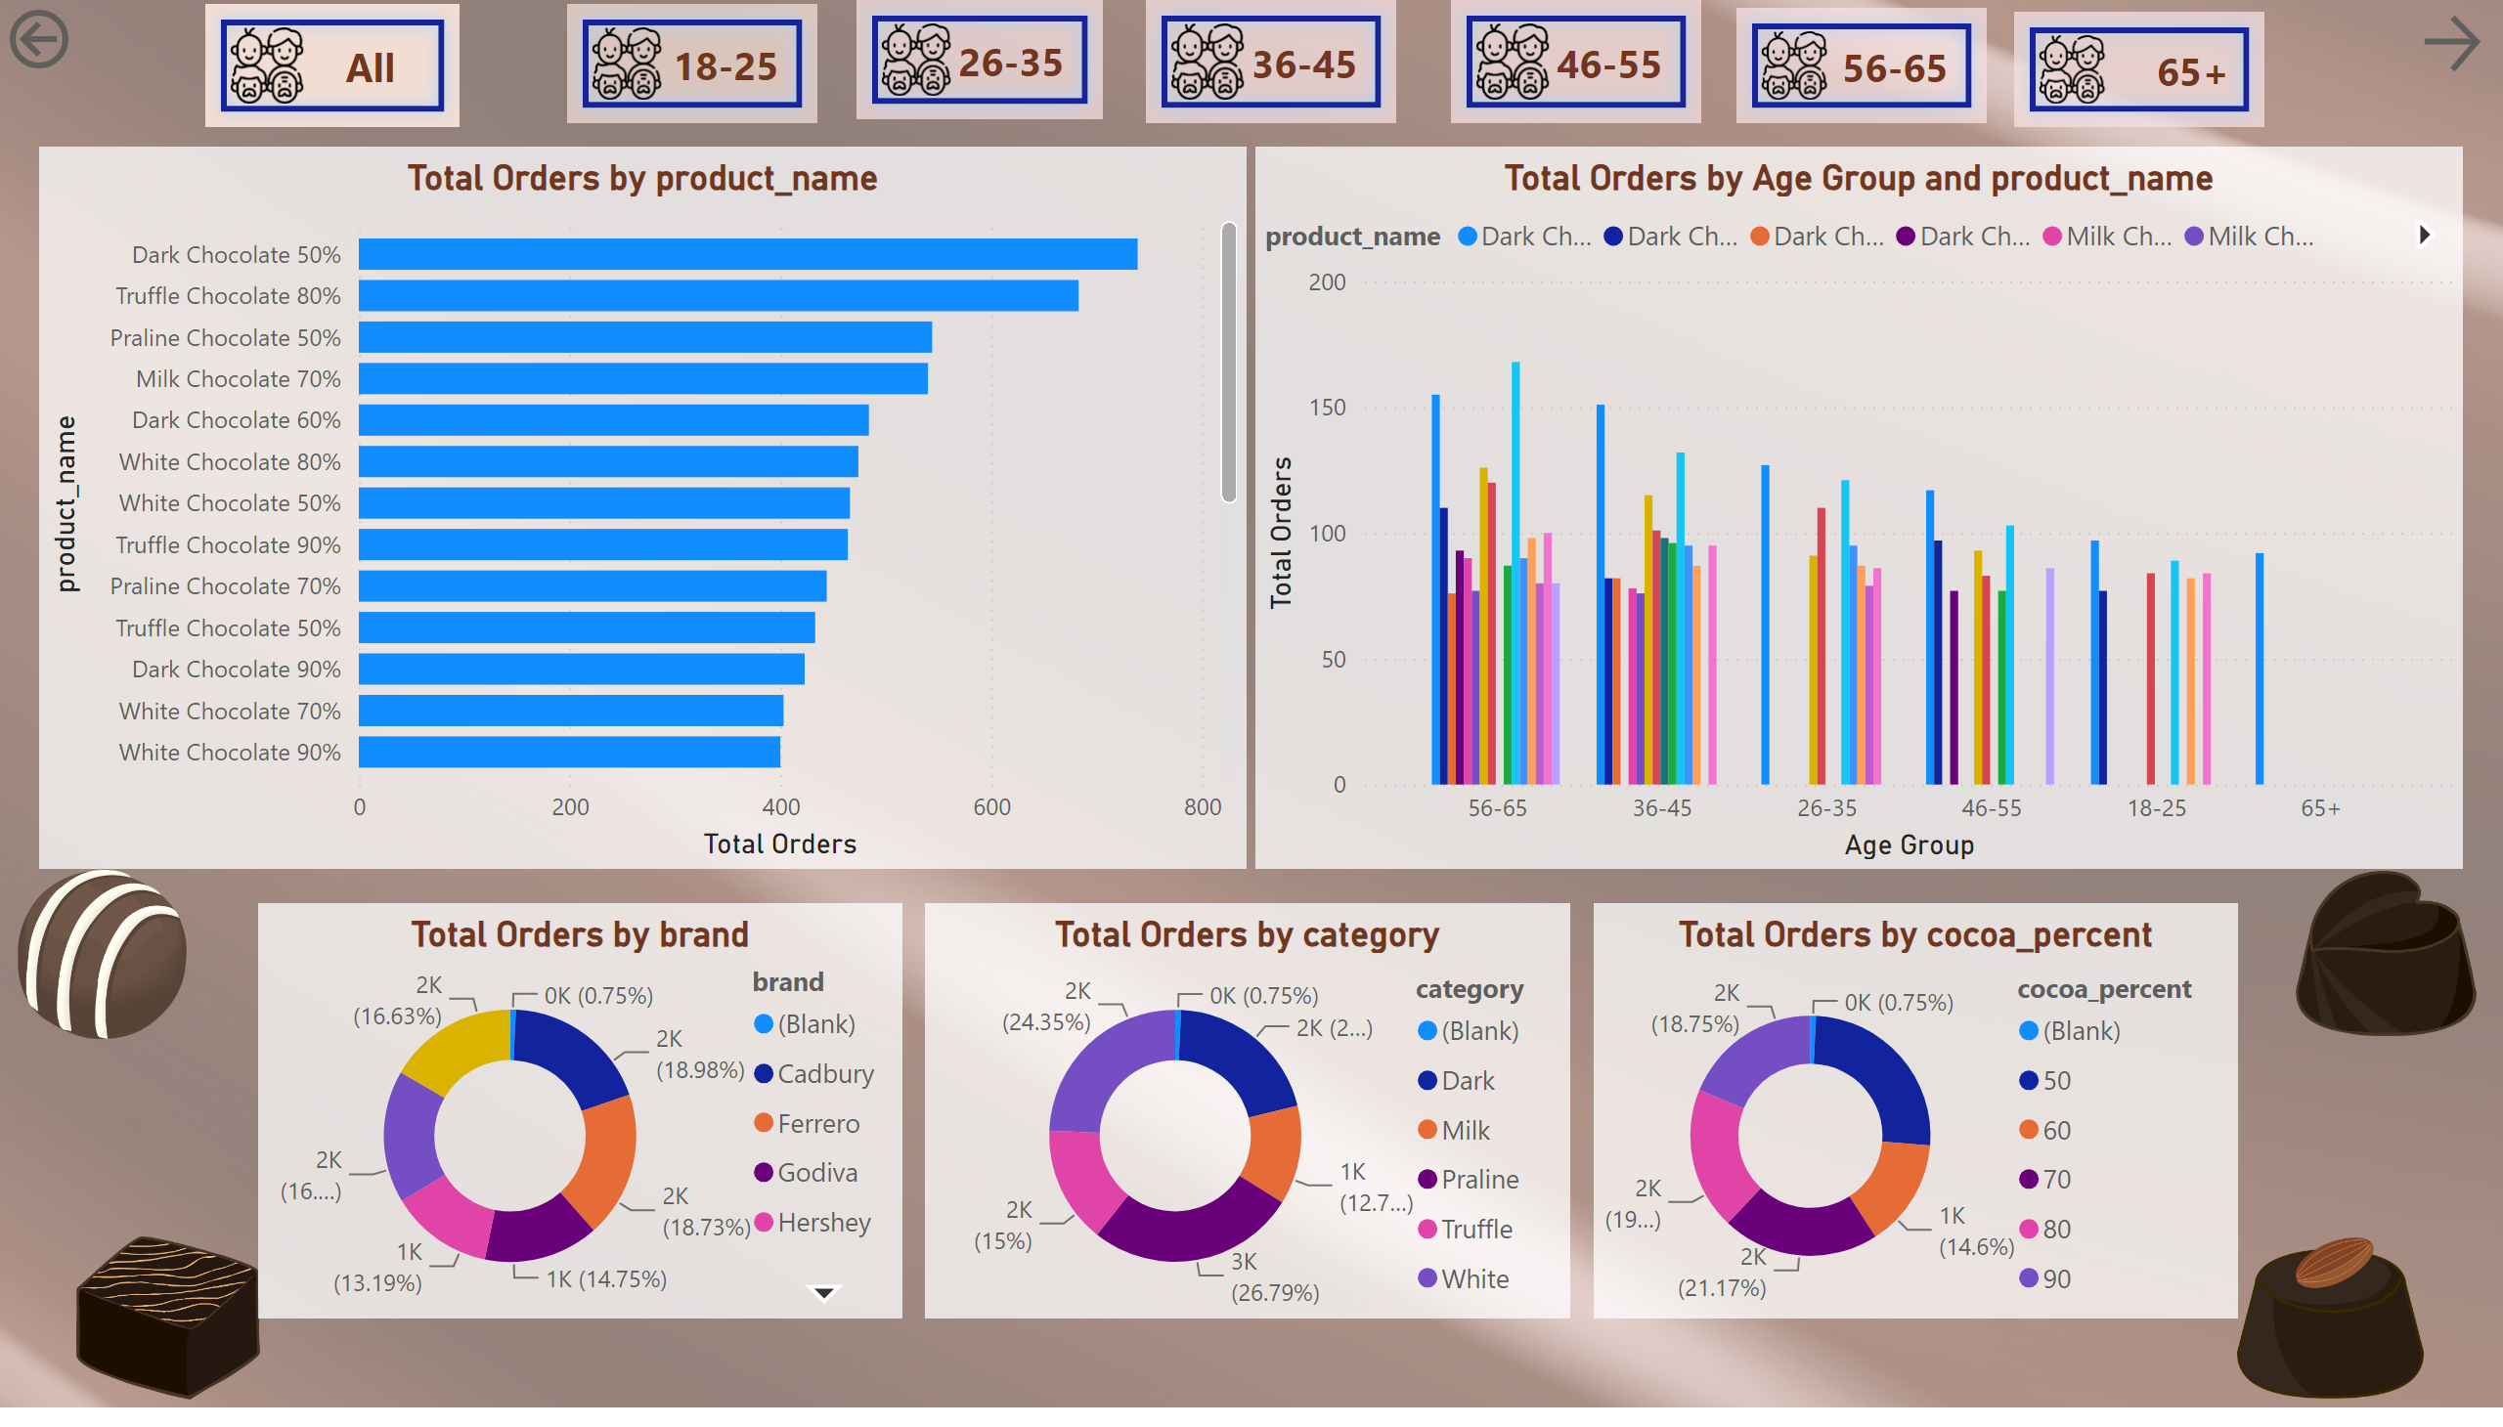
Notes:
clusteredBarChart
No alt text provided
clusteredColumnChart
No alt text provided
actionButton
No alt text provided
actionButton
No alt text provided
actionButton
No alt text provided
actionButton
No alt text provided
actionButton
No alt text provided
actionButton
No alt text provided
actionButton
No alt text provided
image
No alt text provided
image
No alt text provided
image
No alt text provided
image
No alt text provided
actionButton
No alt text provided
donutChart
No alt text provided
donutChart
No alt text provided
donutChart
No alt text provided
actionButton
No alt text provided

Slide 4
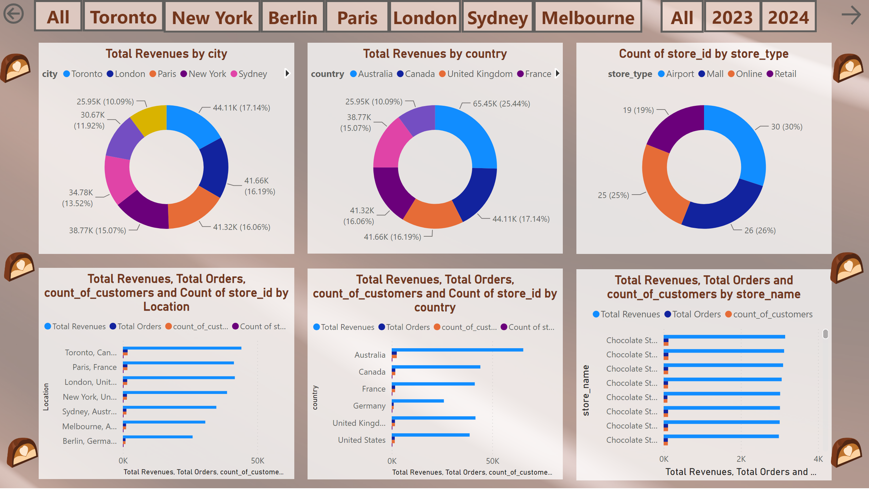
Notes:
clusteredBarChart
No alt text provided
donutChart
No alt text provided
actionButton
No alt text provided
donutChart
No alt text provided
donutChart
No alt text provided
actionButton
No alt text provided
actionButton
No alt text provided
actionButton
No alt text provided
image
No alt text provided
image
No alt text provided
image
No alt text provided
image
No alt text provided
image
No alt text provided
image
No alt text provided
actionButton
No alt text provided
actionButton
No alt text provided
actionButton
No alt text provided
actionButton
No alt text provided
actionButton
No alt text provided
actionButton
No alt text provided
clusteredBarChart
No alt text provided
actionButton
No alt text provided
actionButton
No alt text provided
clusteredBarChart
No alt text provided
actionButton
No alt text provided

Slide 5
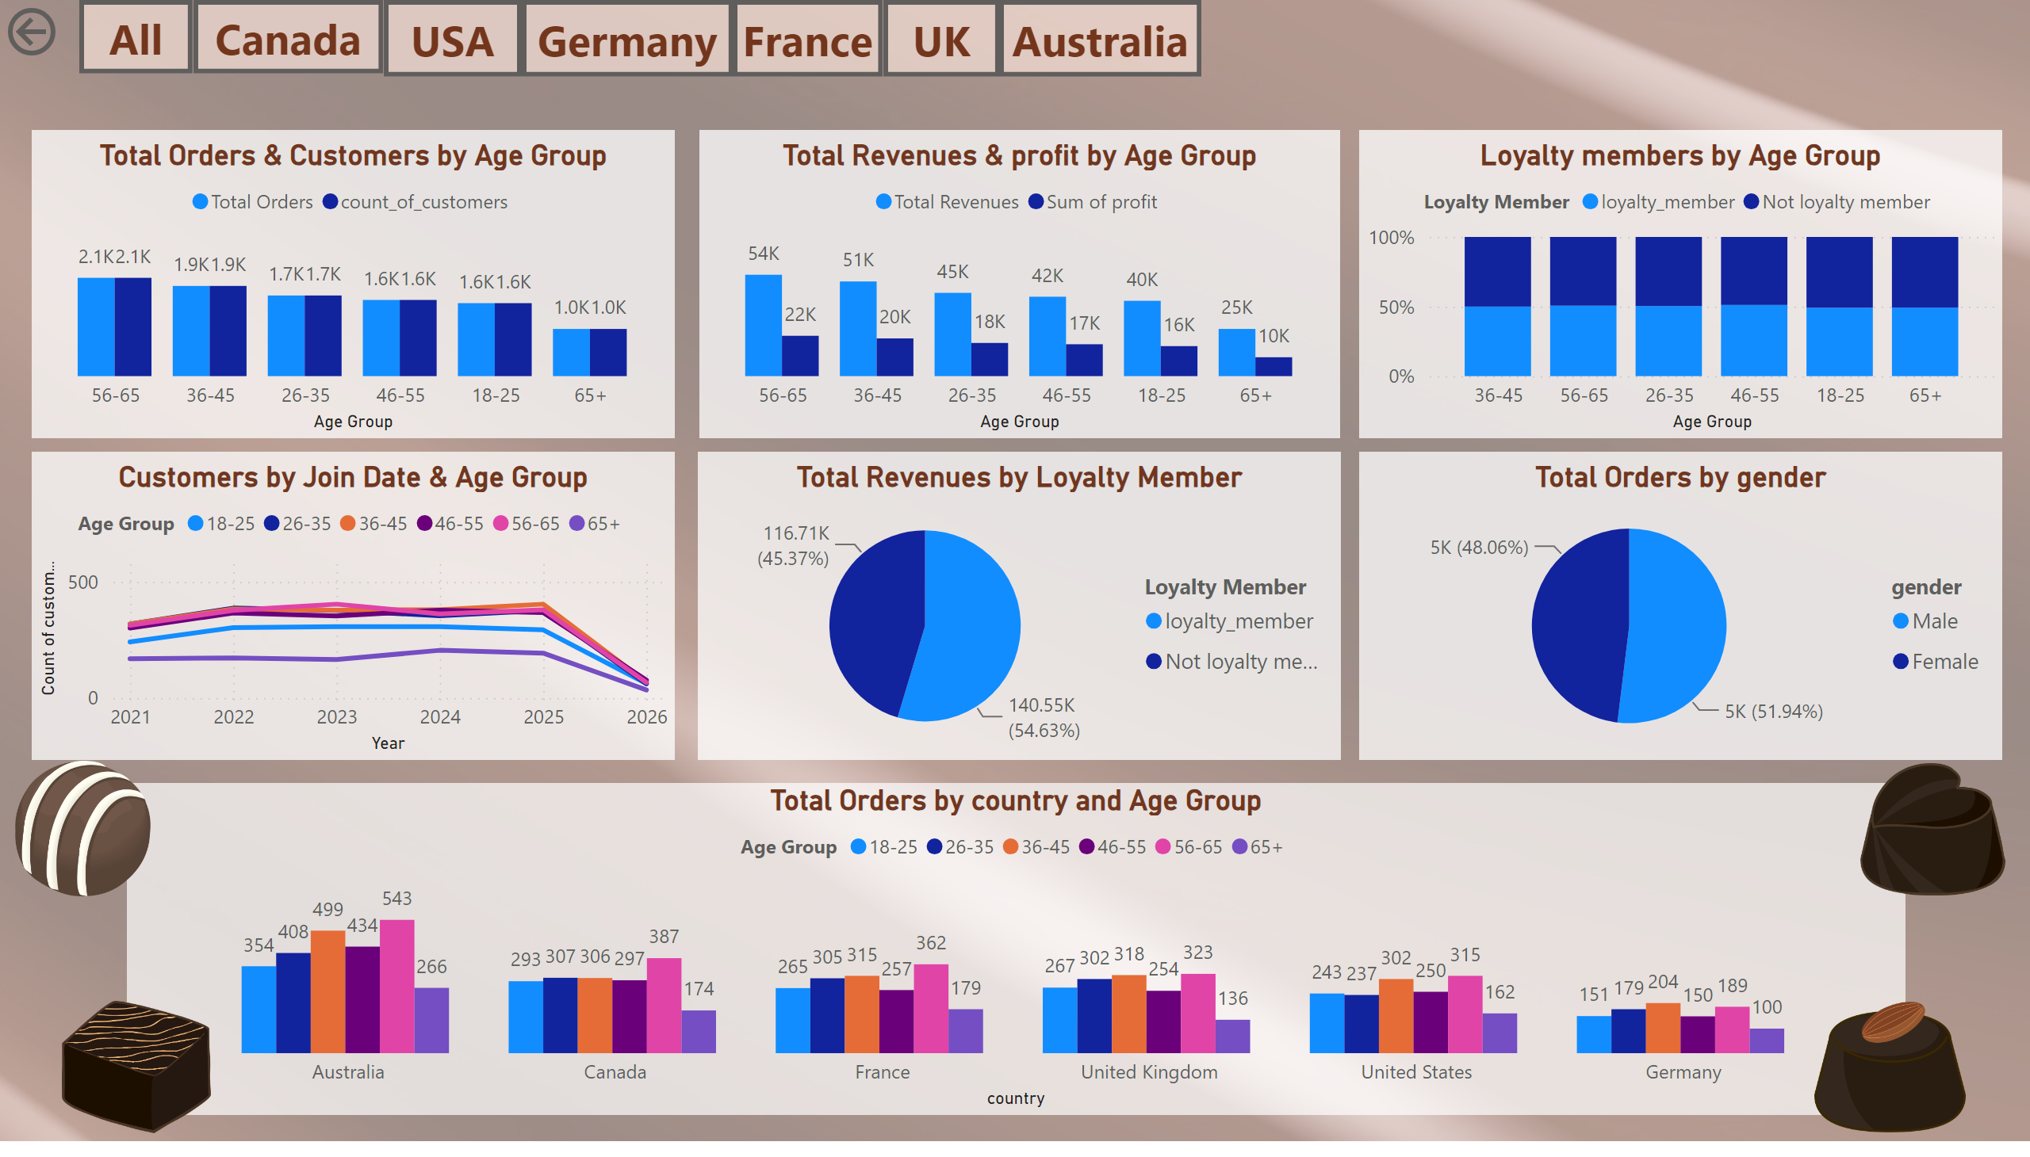
Notes:
pieChart
No alt text provided
Total Orders & Customers by Age Group
No alt text provided
Total Revenues & profit by Age Group
No alt text provided
Loyalty members by Age Group
No alt text provided
pieChart
No alt text provided
clusteredColumnChart
No alt text provided
Customers by Join Date & Age Group
No alt text provided
image
No alt text provided
image
No alt text provided
image
No alt text provided
image
No alt text provided
actionButton
No alt text provided
actionButton
No alt text provided
actionButton
No alt text provided
actionButton
No alt text provided
actionButton
No alt text provided
actionButton
No alt text provided
actionButton
No alt text provided
actionButton
No alt text provided

